Slide 1








uc ion
esi
sis
Name :- Rustam Ali
Roll Number :- 0133CI231230
Branch/Section :- CSIT - ‘D’
Submitted to:
Prof. Pawan Tiwari
Department of Computer Science Engineering and Information Technology

Slide 2
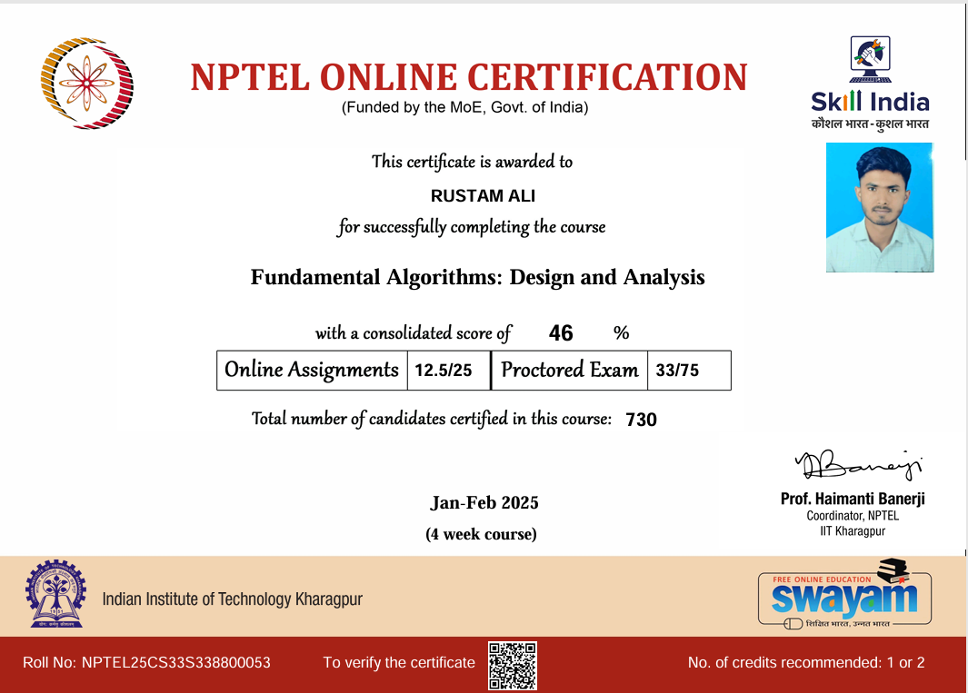

Slide 3


on en
Terminologies
Course Objective
Skeleton of the ADA
Introduction to ADA
Asymptotic Notations
Algorithm Design Techniques

Slide 4
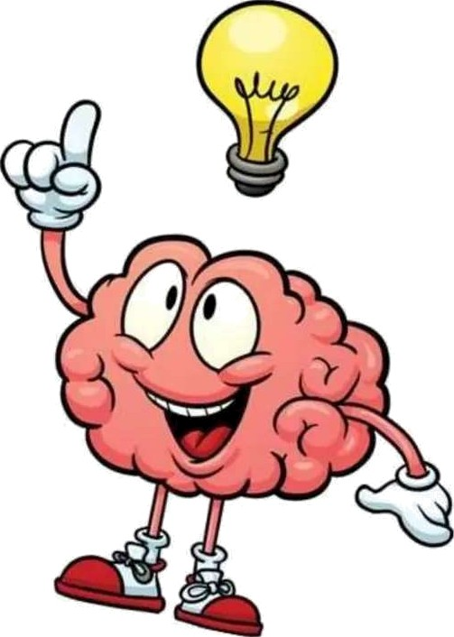

Terminologies:
Algorithm Design:
Methods for designing efficient algorithms.
Algorithm Analysis:
Analysis of resource usage of given algorithms. (Time
Space)

Slide 5


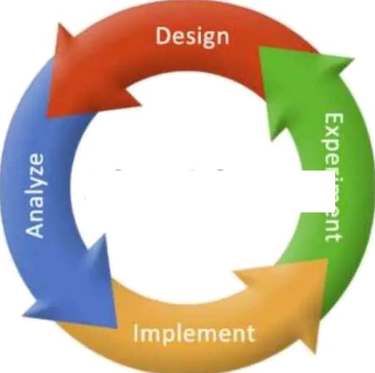
ourse
ec we:
The data structure includes analyzing various algorithms along with time and space complexities. also helps students to design new algorithms through mathematical analysis and programming.
Algorithms j§

Slide 6


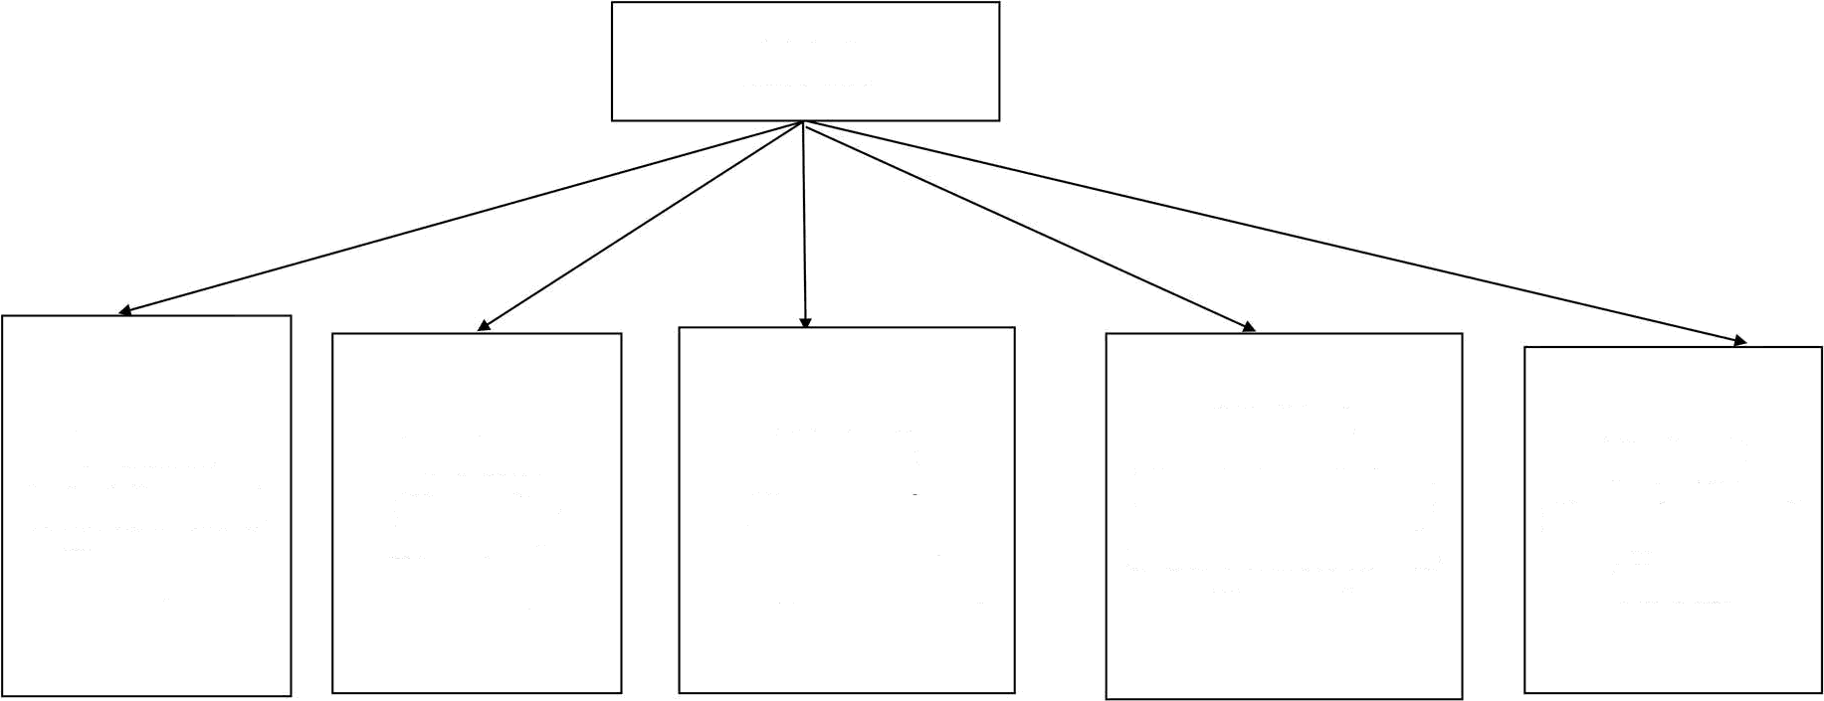
eie on
ADA
Unit:4 Backtracking and Branch & Bound
ÙÎRİti1
Divide and
Conquer
Unit:2
Greedy
Strategy
Unit:3 Dynamİc Programming
Unit:5 Graphs and Trees

Slide 7
INTRODUCTION
The set of rules that define how a particular problem can be solved in finite number of steps is known as algorithm.
An algorithm is a list of steps (Sequence of unambiguous instructions) for solving a problem that transforms the input into the ouQut.
Problem
Algorithm
Input
Computer
Output

Slide 8


er ies an a m:
An algorithm takes zero or more inputs.
An algorithm results in one or more outputs.
All operations can be carried out in a finite amount of time.
An algorithm should be efficient and flexible.
It should use less memory space as much as possible.
An algorithm must terminate after a finite number of steps.
Each step in the algorithm must be easily understood.
An algorithm should be concise and compact to facilitate verification of their
correctness.

Slide 9


Two main tasks in the study
Algorithms:
Algorithm Design
Analysis of Algorithms

Slide 10


ow o ana ze e a
m?
Algorithm efficiency can be measured by two aspects; STime Complexity: Given in terms of frequency count
Instructions take time.
How fast does the algorithm perform?
What affects its runtime?
7•Space Complexity: Amount of memory required
Data structure take space.
What kind of data structure can be used?
How does choice of data structure affect the runtime?

Slide 11

ie ions:
S Given two algorithms for a task, how we find out which one is better?
It might be possible that for some inputs, first algorithm performs better than
the second. And for some inputs second performs better.
Or it might also be possible that for some inputs, first algorithm perform better on one machine and the second works better on other machine for some other inputs.
R So Asymptotic Notation is the big idea that handles above issues in analysing algorithms. In Asymptotic Analysis, we evaluate the performance of an algorithm in terms of input size.
R Using Asymptotic Analysis we can very well conclude the Best Case, Average Case, and Worst Case scenario of an algorithm.

Slide 12


esi ies:
We can design an algorithm by choose the one of the following strategies:
Divide and Conquer
Greedy Algorithm
Dynamic programming
Backtracking
Branch and Bound

Slide 13



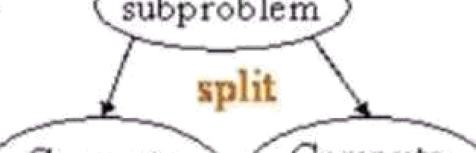
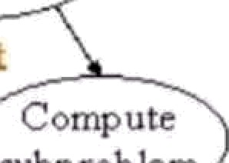




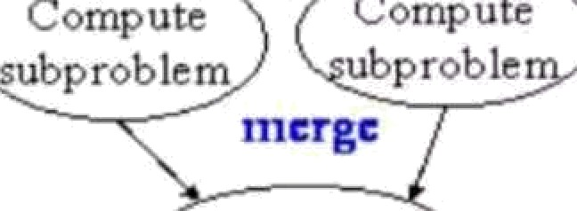






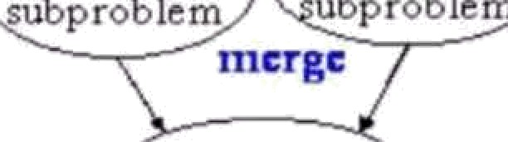

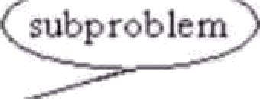
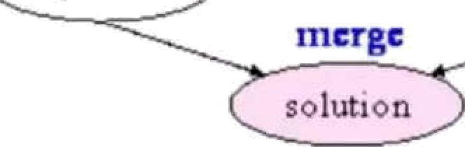
on uer trate
The algorithm which follows divide and conquer technique involves 3 steps:
Divide the original problem into a set of sub problems.
Conquer (or solve) every sub-problem individually, recursive.
Combine the solutions of these sub problems to get the solution of original
problem.
\• Problems that follow divide and conquer strategy:
Merge Sort
Binary Search
Strassen's Matrix Multiplication
probl
(, subp rub lem q)
b bl
corp- ute

Slide 14


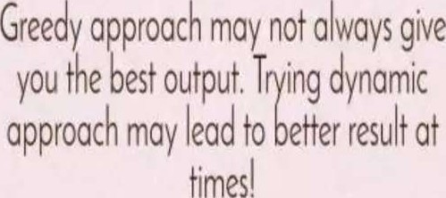

ree ra‹e
Greedy technique is used to solve an optimization problem. (Repeatedly do what is
best now)
An Optimization problem is one in which, we are given a set of input values, which are required to be either maximized or minimized (known as objective function) w.r.t. some constraints or conditions.
The greedy algorithm does not always guarantee the optimal solution but it generally produces solutions that are very close in value to the optimal.
J+ Problems that follow greedy strategy:
Fractional Knapsack Problem
Minimum Spanning Tress
Single Source Shortest Path Algorithm
Job Sequencing With Deadline

Slide 15
Dynamic Programming
Dynamic programming is a technique that breaks the problems into sub- problems, and saves the result for future purposes so that we do not need to compute the result again.
The subproblems are optimized to optimize the overall solution is known as
optimal substructure property.
RProblems that follow dynamic strategy:
0/1 Knapsack
Matrix Chain Multiplication
Multistage Graph

Slide 16
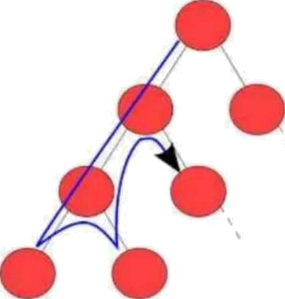
Backtracking
Backtracking is an algorithmic technique for solving problems by trying to build a solution incrementally, one piece at a time, removing those solutions that fail to satisfy the constraints of the problem at any point
Backtracking is not used for optimization. Backtracking basically means trying all possible options. It is used when you have multiple solution and you want all those solutions.
SProblems that follow backtracking strategy:
N-Queen’s Problems
Graph Colouring
Hamiltonian Cycle

Slide 17


